Slide 1
OBI Core
Jie Zheng
Center for Bioinformatics
University of Pennsylvania

Slide 2
OBI 2012 spring release
Total 3539 classes, 161 instances
  OBI Classes 1935
  Imported Classes 1593
    NCBITAXON 1170
    IAO 109
    GO 102
    CHEBI 53
    PATO 49
    BFO 27
    UBERON 20
    CL 19
    PR 15
    UO 11
    CARO 5
    SO 3
    OGMS 3
    ENVO 3
    VO 2
    HP 1
    GAZ 1

Slide 3
Principles to select CORE terms
As small as possible to make it quick to go through while also being easy to understand and giving an overview of all areas covered in OBI and the main design patterns
It should cover the stable areas, and changes to components of the core should be avoided
For each core terms, choose 2 example subclasses that indicate what kind of children are expected
(core or education view of OBI?)

Slide 4
OBI core terms
https://docs.google.com/spreadsheet/ccc?key=0ApyYCnScx8C0dEVCUGtZZ3FIV3JKMEw3YkVsUlJjX1E#gid=1
9 OBI developers marked the terms that they thought to be CORE terms of OBI and add some comments
obi_core.owl generated using Ontodog (http://ontodog.hegroup.org/)

Slide 5
OBI core OWL files
A total of 170 terms chosen as core by at least 2 developers
A total of 483 terms chosen as core by at least 1 developers
OWL files that included all selected core terms with the related terms for keeping extracted subset of ontology consistency.
  170 terms -> 391 classes in the OWL file
  483 terms -> 715 classes in the OWL file

Slide 6
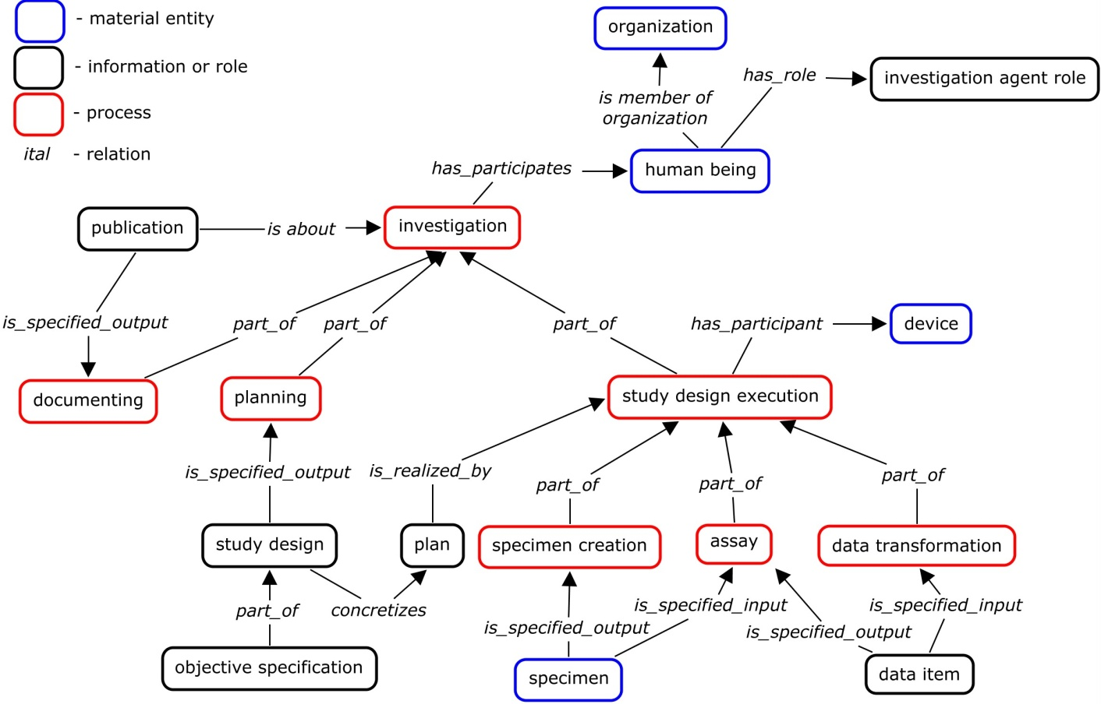
OBI core (13 classes)
Too many terms in the OWL file, hard to review
Start with a small set of terms, 13 terms -> 82 classes
  assay
  specimen
  data item
  investigation
  planning
  documenting
  study design
  device
  investigation agent role
  protocol
  study design execution
  data transformation
  publication

Slide 7
Reviewed by Philippe
Missing classes in the 13 core terms OBI file
Material Entity/IAO:material information bearer
(rationale -> needed for information content entity)
Material Entity/OBI:population
(rationale ->up one granularity level from organism)
Material Entity/CHEBI:molecular entity
(rationale ->allow reporting of molecular biology studies)
Site
independent variable specification & dependent variable specification (rationale -> relates to study design)
information content entity/CRID symbol + CRID registry
(rationale -> reporting of xref or any identification schema)
Planned Process/acquisition
(rationale: complementing 'specimen creation' process)
classes related to measurement datum

Slide 8
OBI core (23 classes)
Add 10 more terms in the CORE
  material information bearer
  population
  molecular entity
  site
  independent variable specification
  dependent variable specification
  CRID symbol
  CRID registry
  acquisition
  measurement datum
23 core terms -> 94 classes

Slide 9
Reviewed in the Workshop
(33 core classes)
CRID registry
CRID symbol
assay
data item
data transformation
dependent variable specification
device
document
documenting
enrollment
hypothesis textual entity
independent variable specification
investigation
investigation agent role
material information bearer
measurement datum
plan
planning
protocol
specimen
study design
study design execution
study subject role

Slide 10
Core Classes
Refer to external ontology
molecular entity (ChEBI)
quality (PATO)
geographical location (Gazetteer)
biological process (GO)
cellular_component (GO)
cell (CL, cell type)
organism (NCBITaxon)
gross anatomical part (CARO)
Missing:
molecular function (GO)
disease course (OGMS)
Candidate
measurement function
population
Acquisition
31 core -> 104 Classes

